Slide 2

Factorial as an integral - Gamma and pi funtion
$x! =Π(x)=Γ(x+1)=\int_{0}^{∞}{t^{x}e^{−t}dt}$
$Π(−\frac{1}{2})= \int_{0}^{∞}{\frac{e^{−t}}{\sqrt{t}}dt}$ = (main)
substitution:
$u=\sqrt{t}$
$u^{2}=t$
2udu= dt
(main) = $\int_{0}^{∞}{\frac{e^{−u^{2}}}{u}2udu}=$ 2 $\int_{0}^{∞}{e^{−u^{2}}du}$
recall : gauss integral = $\int_{0}^{∞}{e^{−u^{2}}du}$ = $\frac{\sqrt{π}}{2}$
(main) = $\sqrt{π}$
known: $(\frac{1}{2})!=\frac{\sqrt{π}}{2}$
check: $(−\frac{1}{2})$!=$\frac{(\frac{1}{2})!}{\frac{1}{2}}= \sqrt{π}$
$Π(−1) diverges щт 0..1:$
limit comparation test:
$\lim_{x→0}{\frac{\frac{1}{x}}{\frac{1}{xe^{x}}}}=|e^{x}−>1| = 1, so \frac{1}{xe^{x}} behaves like \frac{1}{x}$ on x -> 0

Slide 3
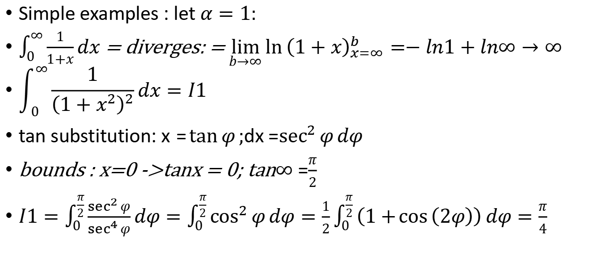

$$\int_{0}^{∞}{\frac{1}{{\left(1+x^{α}\right)}^{α}}}dx=1 (part 1)$$
Simple examples : let $α=1:$
$\int_{0}^{∞}{\frac{1}{1+x}}dx$ = diverges: = $\lim_{b→∞}{\ln{{\left(1+x\right)}_{x=∞}^{b}}}=−ln1+ln∞→∞$
$$\int_{0}^{∞}{\frac{1}{{\left(1+x^{2}\right)}^{2}}}dx=I1$$
tan substitution: $x=\tan{φ};$dx =$\sec^{2}{φ}dφ$
bounds : x=0 ->tanx = 0; tan$∞$ =$\frac{π}{2}$
$I1=\int_{0}^{\frac{π}{2}}{\frac{\sec^{2}{φ}}{\sec^{4}{φ}}}dφ=\int_{0}^{\frac{π}{2}}{\cos^{2}{φ}}dφ=\frac{1}{2}\int_{0}^{\frac{π}{2}}{\left(1+\cos\left(2φ\right)\right)}dφ=\frac{π}{4}$

Slide 4
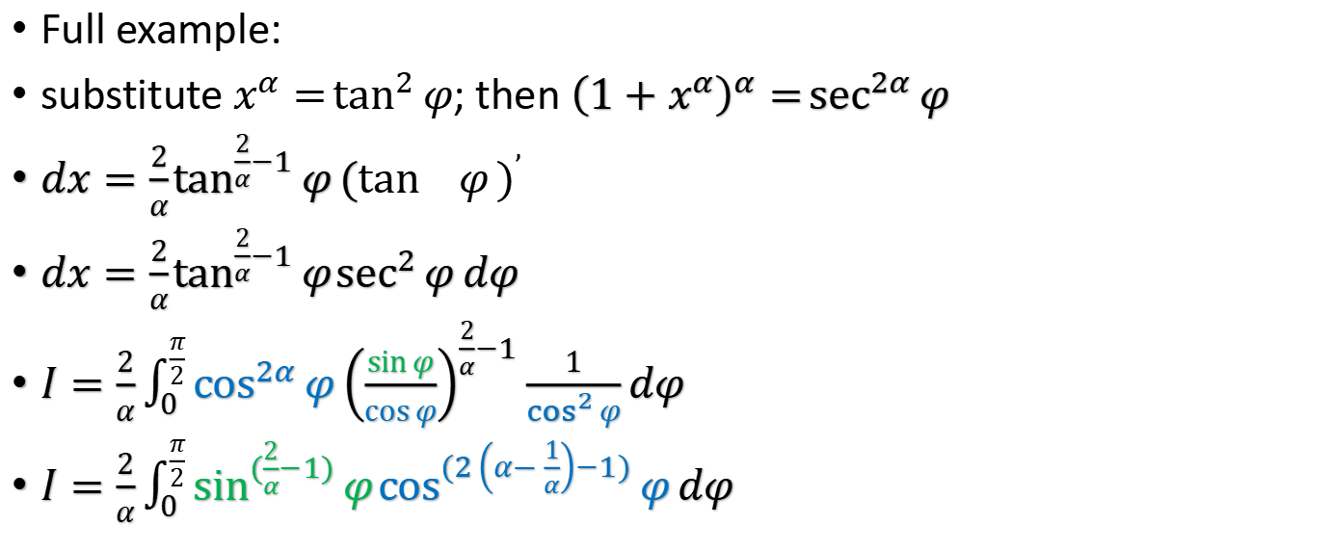

$$\int_{0}^{∞}{\frac{1}{{\left(1+x^{α}\right)}^{α}}}dx=1 (part 2)$$
Full example:
substitute $x^{α}=\tan^{2}{φ}$; then ${\left(1+x^{α}\right)}^{α}=\sec^{2α}{φ}$
$dx=\frac{2}{α}\tan^{\frac{2}{α}−1}{φ}{(\tan^{}{φ})}^{’}$
$dx=\frac{2}{α}\tan^{\frac{2}{α}−1}{φ}\sec^{2}{φ}dφ$
$I=\frac{2}{α}\int_{0}^{\frac{π}{2}}{\cos^{2α}{φ}}{\left(\frac{\sin{φ}}{\cos{φ}}\right)}^{\frac{2}{α}−1}\frac{1}{\cos^{2}{φ}}dφ$
$I=\frac{2}{α}\int_{0}^{\frac{π}{2}}{\sin^{(\frac{2}{α}−1)}{φ}}\cos^{(2\left(α−\frac{1}{α}\right)−1)}{φ}dφ$

Slide 5
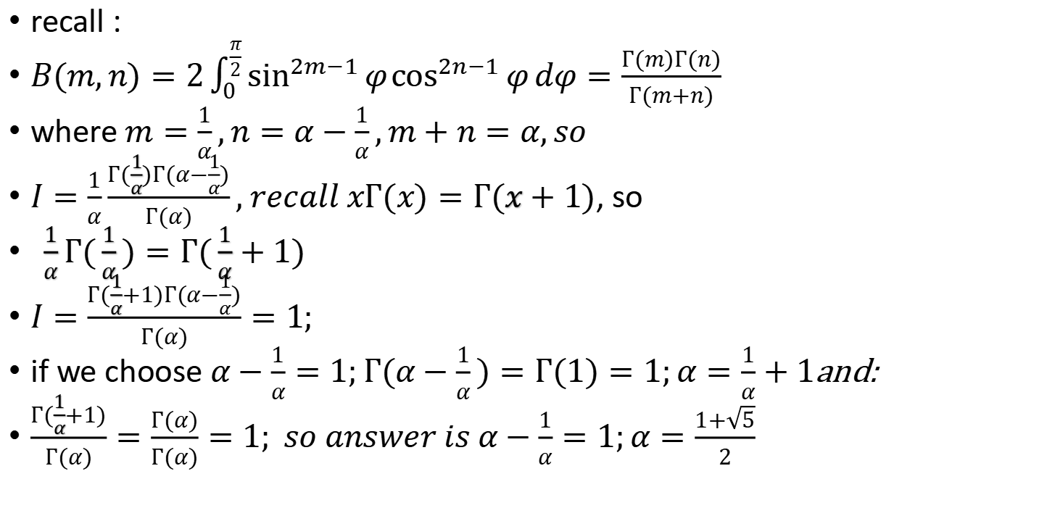

$$\int_{0}^{∞}{\frac{1}{{\left(1+x^{α}\right)}^{α}}}dx=1 (part 3)$$
recall :
$B(m,n)=2\int_{0}^{\frac{π}{2}}{\sin^{2m−1}{φ}}\cos^{2n−1}{φ}dφ=\frac{Г(m)Г(n)}{Г(m+n)}$
where $m=\frac{1}{α},n=α−\frac{1}{α},m+n=α,so$
$I=\frac{1}{α}\frac{Г(\frac{1}{α})Г(α−\frac{1}{α})}{Г(α)}, recall xГ(x)=Г(x+1)$, so
$\frac{1}{α}Г(\frac{1}{α})=Г(\frac{1}{α}+1)$
$I=\frac{Г(\frac{1}{α}+1)Г(α−\frac{1}{α})}{Г(α)}=1;$
if we choose $α−\frac{1}{α}=1;Г(α−\frac{1}{α})=Г(1)=1;α=\frac{1}{α}+1$and:
$\frac{Г(\frac{1}{α}+1)}{Г(α)}=\frac{Г(α)}{Г(α)}=1; so answer is α−\frac{1}{α}=1;α=\frac{1+\sqrt{5}}{2}$

